Slide 1
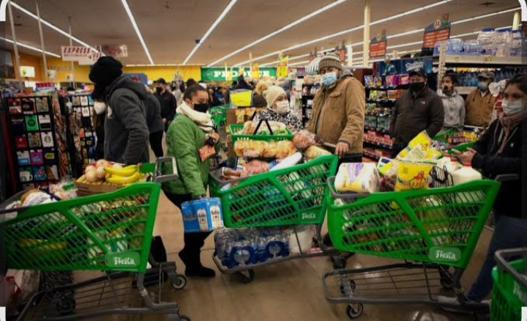
SALES ANALYSIS

Slide 2
TABLE OF CONTENT
Gantt Charts………………………………………………..3
Miro Diagram ……………………………………………..4
SQL……………………………………………………………..5
Dashboard…………………………………………………..6
Recommendations……………………………………….9

Slide 3
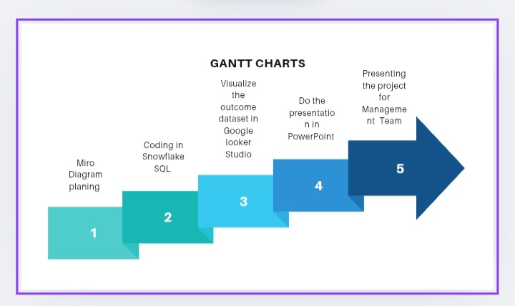

Slide 4
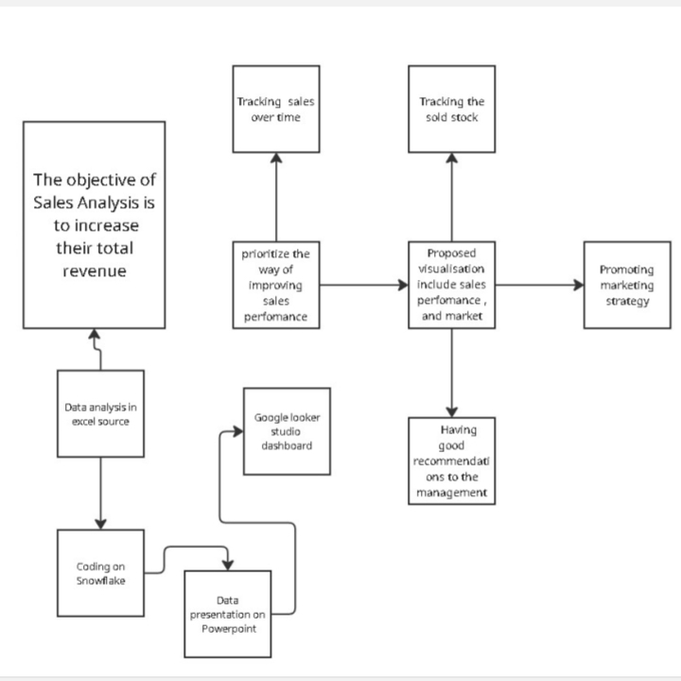
Table of Content
Miro Diagram Planning………………………………..

Slide 5
SQL
The SQL code calculates how much was sold each day.
It groups all sales by date, then adds them up to find the total revenue.
For the Sold quantity it adds up number of sold units on each day.
Leading to days with high product sales anddays with low
For scatter plot then it compares how cost relates to revenue also positive correlation.

Slide 6
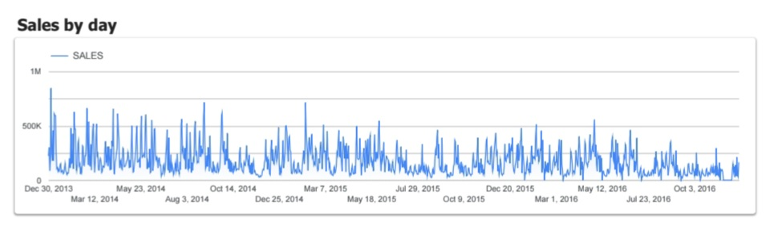
,
The above line graph displays daily sales performance from 2013 to october 2016.
Overall sales are highly volatile with frequent spikes and drops.
Several dates show exceptionally high performance, indicating promotion/ Sale on these following dates. Early Jan, late May, Early Dec, Late April, Dec 2015, April to May 2016, Late July 2016. Daily sales are stable but highly reflecting customer buying behaviour.

Slide 7
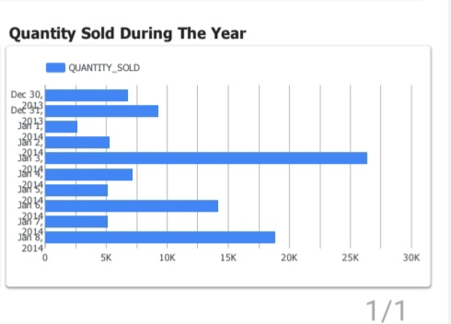
The bar chart displays quantities sold over several dates between late Dec 2013 and Jan 2014. It help us see which days experienced higher sales volume and which days had lower activity.
Early Jan is strong sales period.
Late Dec shows moderate activity.
High and Low indicate importance of preparing sufficient stock for high demand.

Slide 8
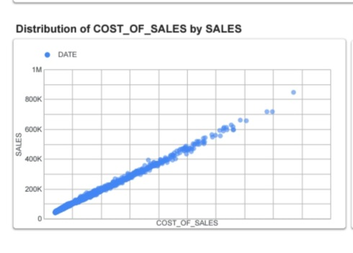
This scatter plot shows the relationship between Cost of Sales and Sales for the business.
It shows a strong positive correlation as Cost of Sales increase also Sales increase.
Most points lie close together in a straight this means the business has consistent cost control and stable pricing.

Slide 9
Recommendations
The graphs show a business with a strong seasonal demand patterns, predictable cost behaviour and opportunities to optimise sales spikes.
By strengthening promotions during high demand periods, improving inventory forecasting and stabilizing daily sales.
The organisation can significantly boost both revenue and profitability.

Slide 10
THANK YOU
.

